Slide 1
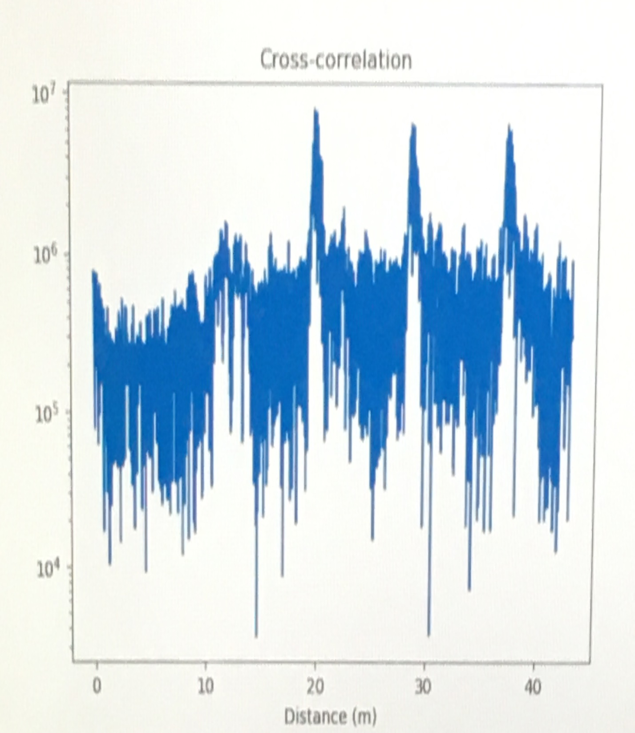
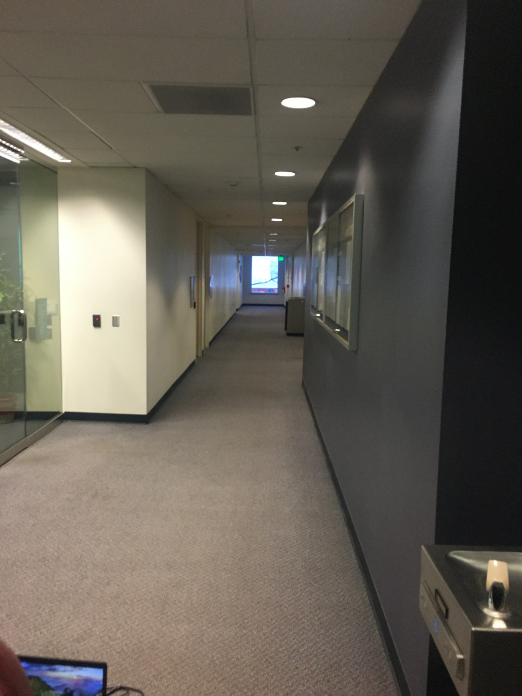

Slide 2
Possible Reasons for Peak at 40m
Multipath
Interference Effects
Probably not the case
Incorrect rolling
If this was the case the first peak would be the transmit pulse, the second peak would be the trash can, and the third would be the wall.
Probably not the case as
The hallway is longer than 20m
When a person stood in the hallway we saw the peak approximately where the person was standing which indicates correct rolling

